Slide 1
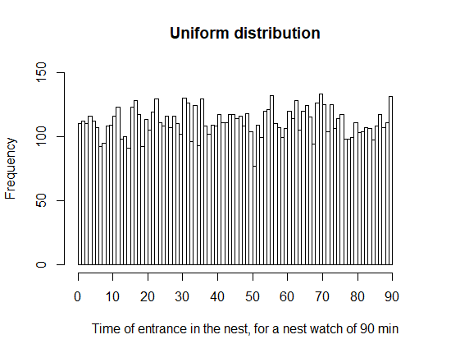
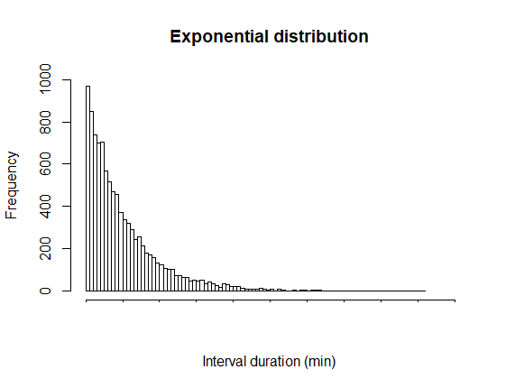
Poisson process assumption: exponentially distributed intervals
=
Shorter intervals are more likely – no refractory period

Slide 2
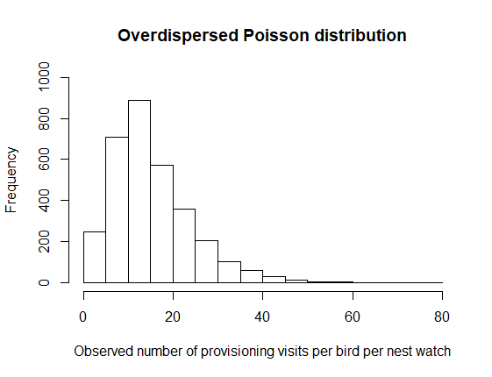
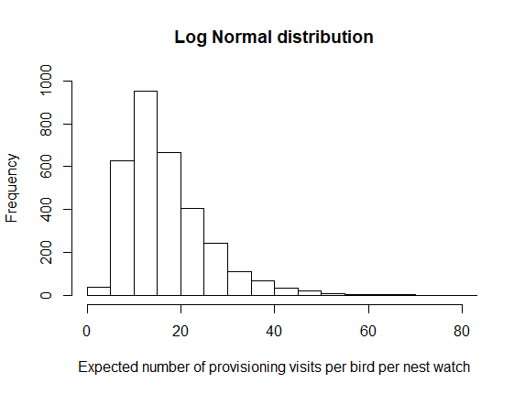
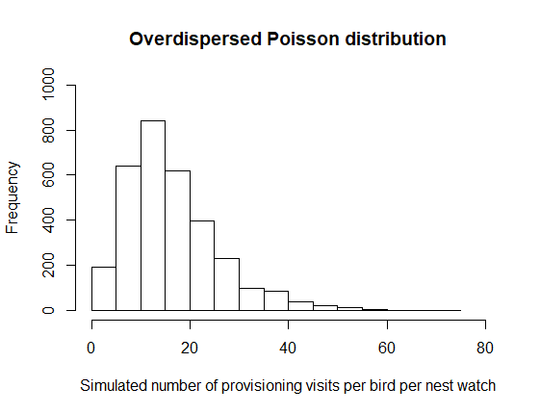
Simulation of exponentially distributed intervals
1. Generate provisioning rates
a. Extract observed mean and SD
d. Simulate expected provisioning rates
e. Add Poisson distributed error to obtain simulated provisioning rate
b. Transform to expected mean and SD by removing Poisson distributed stochastic error
c. Transpose to the log scale using Jensen’s inequality

Slide 3
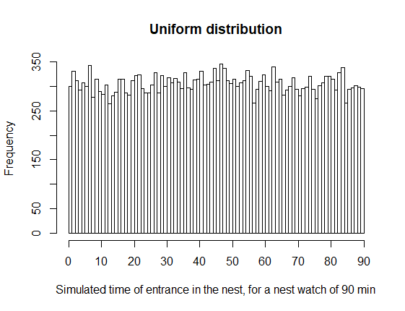
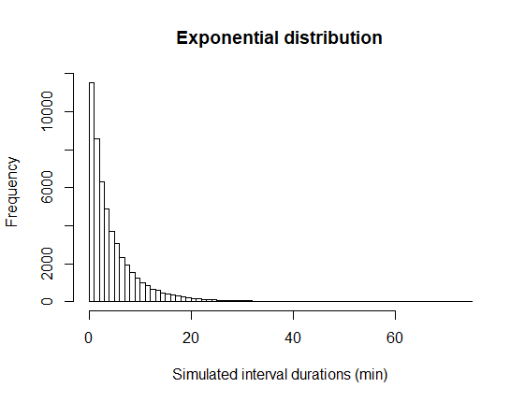
Simulation of exponentially distributed intervals
2. Generate nest visits
3. Repeat 1. and 2. for each partners
4. Combine male and female’s nest visit times to form a simulate nest watch and calculate the number of alternated and synchronized visits
=
5. Repeat 1599 times (the number of observed nest watches)
a. For each bird and its number of provisioning visit simulated, draw a similar number of nest entrance times

